Slide 1
QUESTION 2
The analysis is based only on significant variables.

Slide 2
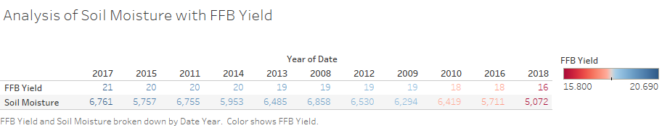

Slide 3
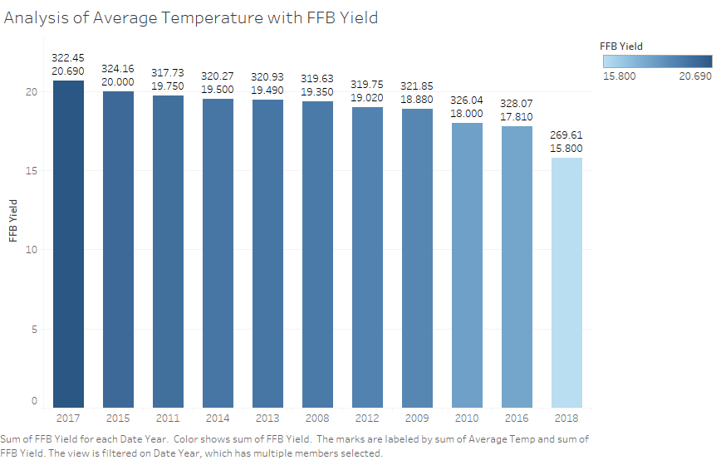

Slide 4
Analysis of Soil Moisture with FFB yield
Considering the distribution of values in the data, these values are expected to be between 5552 and 6777. Based on the Analysis of Soil Moisture with FFB Yield, sum of soil moisture for 2008, 2010,2011,2012,2013 and 2017 are higher than expected but within the range of natural variation. For year 2009,2015 and 2016, the values are lower than expected but within the range of natural variation. 2018 recorded the lowest expected value of all the records.
Based on the oil palm tree physiology, Oil palm tree soil moisture content should be between 30% to 75% . The hypothesis is, if soil moisture is higher than the expected range, the fresh fruit bunch yield will fluctuate.
The amount of water and heat energy exchanged between the land surface and the atmosphere via evaporation and plant transpiration is controlled by soil moisture. As a result, soil moisture has a significant impact on the formation of weather patterns and precipitation.
As we can see, the fresh fruit bunch yield for the year 2017 is the highest and the soil moisture content is higher than expected but within the range of natural variation. However in year 2018, the soil moisture is the highest but the ffb yield did not record significant result. This shows that if the soil moisture content is too high, the ffb yield will not improve. To get the most significant result as the year 2017, the soil moisture content must not exceed the natural variation value with correct amount of other factors like pest control and type/amount of fertilizer used assuming that the plantation field area is the same for every year.

Slide 5
Analysis of Average Temperature with FFB Yield
Considering the distribution of values in the data, these values are expected to be between 17724 and 20074. Based on the Analysis of Average Temperature with FFB Yield, ffb yield for 2017,2015,2011, 2014, 2013 and 2008 are higher than expected but within the range of natural variation. For year 2012,2009,2010 and 2016, the values are lower than expected but within the range of natural variation. 2018 recorded the lowest expected value of all the records.
Based on the oil palm tree physiology, in order for oil palm tree to thrive, it needs the humid condition ranges from 22-24 ֯ c minimum and maximum of 20-33֯c for optimal growth . The hypothesis is, if average temperature is between 20-33֯c, the ffb yield will be high.
In 2017, the fb yield is the highest as the average temperature is the most optimum. Palms may be less able to withstand pests and diseases when conditions are less than ideal for oil palm, such as when temperatures are low or water is scarce, resulting in production loss. Climate change may have a detrimental influence on oil palm pollination, resulting in lower yields like in year 2018.

